Slide 1

CORONA VISUALIZATION AND PREDICTION
G H RAISONI COLLEGE OF ENGINEERING & MANAGEMENT, AHMEDNAGAR
(APPROVED BY AICTE, NEW DELHI, RECOGNIZED BY GOVT. OF MAHARASHTRA & AFFILIATED TO SAVITRIBAI PHULE PUNE UNIVERSITY)
NAAC ACCREDITED
DTE Code : 5176
Presented By:
Snehal Kolhe
Vaishnavi Changle
Abhishek Gore
Sourabh Yeshal Guided BY: Prof.Y.Sisodiya
Girish Puranik (Head Of Department)

Slide 2
CONtents
Introduction
Literature Survey
System Architecture
Data Cleaning
Data Visualization
DFD Diagrams
Advantages
Disadvantages
Conclusion
Future Scope
Reference

Slide 3
INTRODUCTION
Infectious diseases are caused by various pathogens that can be transmitted from person to person, animal to animal, or person to animal.
They can be transmitted in various ways, and the speed of transmission is fast.
The virus, named the 2019 Novel Coronavirus (2019-nCoV) by the World Health Organization (WHO) on January 12, 2020, causes Corona Virus Disease 2019 (COVID-19).

Slide 4
COVID–19 ANALYSIS, VISUALIZATION AND PREDICTION
Upload CSV file on our notebook to check how its look like
Read CSV file and check null value and missing value in row or column.
Here we are using 4 inbuilt python library like Pandas, Matplotlib, Seaborn and Numpy
1. Pandas, we perform data fetching and analysis
2. Matplotlib and Seaborn for Visualization purpose
3. Numpy we is use for working with arrays.
We create Active Cases column for Visualization purpose
After we plots india covid-19 virus data by state wise.

Slide 5
LITERATURE SURVEY
Sr.No | Paper Title | Author | Publish Year
1. | The transmissibility and control of pandemic influenza A(H1N1)virus. | Yang Y., Halloran M.E. | 2009
2. | Initial public health response and interim clinical guidance for the 2019 novel coronavirus outbreak. | Patel A., Jernigan D.B. | 4 Feb 2020
3. | Clinical features of patients infected with 2019 novel coronavirus in Wuhan,China. | Huang C. | 2020

Slide 6


SYSTEM ARCHITECTURE
Dataset Collection
Of Covid-19 Case
Data Pre-processing and Data Streaming
Visualization

Slide 7
Goal
● To study COVID-19 data to avoid believing misconceptions that the media and those in power try to impose.
● Learn how to interpret different visualizations
● Assess to see how close it is to possibly predict cases and deaths

Slide 8
Why Should We Care About COVID-19?
● There are lot of misconceptions with SARS-COV-2
● “It is not lethal!”
○ This is true, but it has a 20% more mortality rate than the flu!
○ “The issue isn’t the lethality as much as the overall impact of the outbreak. While these other diseases like H1N1, MERS, SARS, may be more lethal, the combination of reproductive factor (R0), receptivity in the population (susceptibility), and immunity may make them much more manageable.

Slide 9
●“Only older adults and people with preexisting conditions are at risk of infections and complications”
○That is true, but no one is safe from complications and deaths.
○COVID-19 is new to the population. So unless, you’re an animal, you’re not immune!
○Ever heard of adults in their 30’s or 40’s getting stroke due to Covid?
●A lot of people lost their their lives.

Slide 10
Data Cleaning
Remove columns
Make date format uniform
Fill nulls with 0s
To create useful column

Slide 11
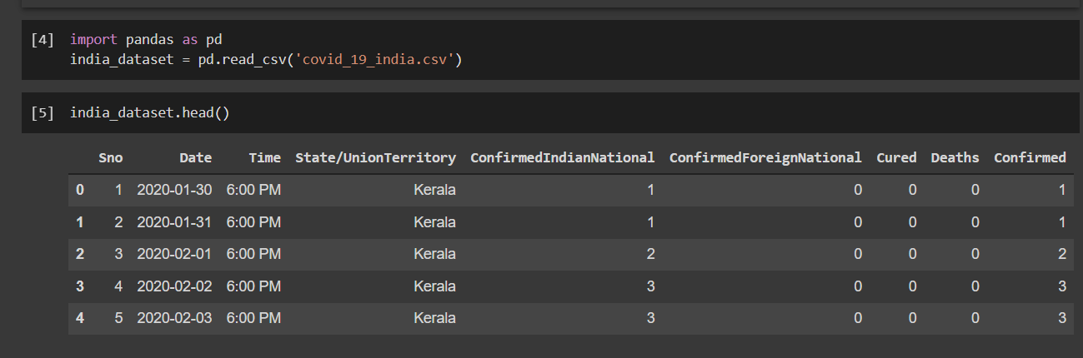
TO CHECK COVID-19 VIRUS CASES IN INDIA
Here we upload CSV data file on google colab notebook.
We import pandas file to read CSV file.
Head() is use to display first 5 columns.

Slide 12
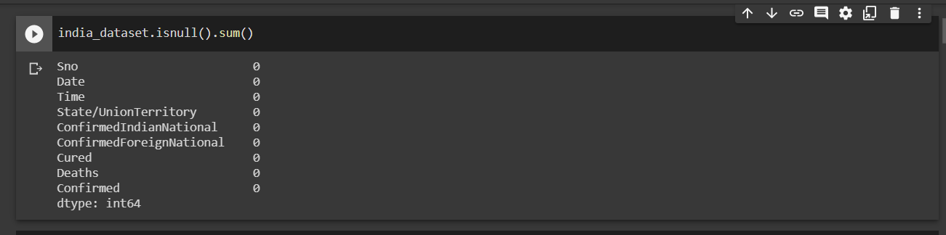
It is necessary to check null value in our data.
There is no missing value.
If we get missing value in our dataset then we need fill missing by taking average value.
If lots of missing value in our dataset then delete that column.
TO CHECK NULL VALUE

Slide 13
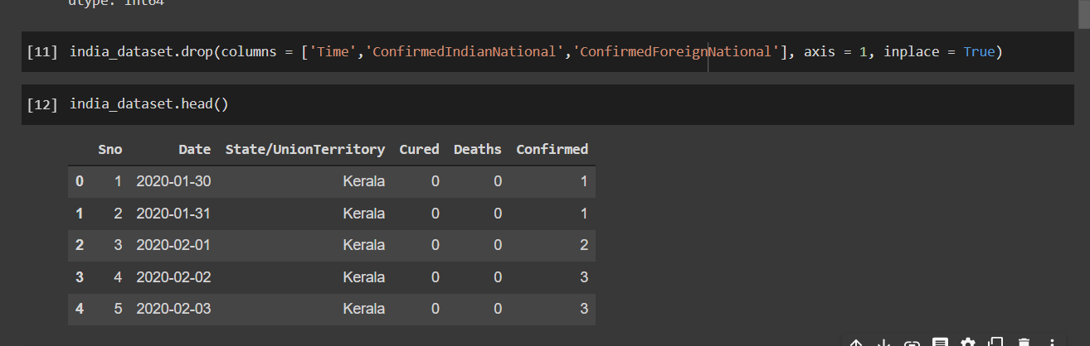
TO DELETE UNNECESSARY COLUMNS FROM DATASET
We need to delete unnecessary column if we don’t use.
After ouput look like

Slide 14
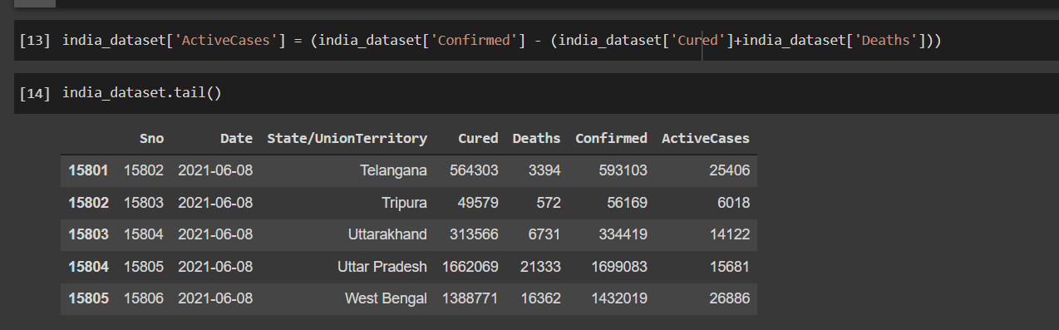
TO CREATE ONE COLUMN OF ACTIVECASE
We create a separate column of active cases by using previous data columns
Active_case = confirmed – (cured+death)

Slide 15
Visualization
To Check all state visualization
To check particular state that highly impacted by COVID-19 virus

Slide 16
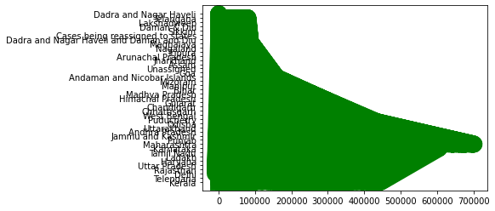
Here we basically understand highly impacted states in India like you can say Maharashtra, Tamil Nadu, Punjab and Delhi.
This plotting show active cases of corona virus

Slide 17
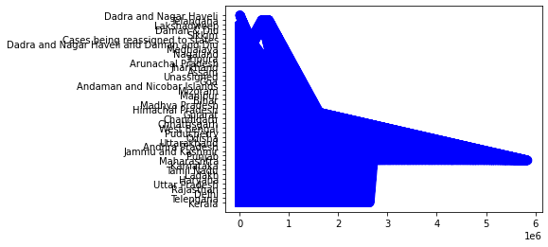
Here we check confirmed case all state in Inda
In plotting Maharashtra has pick on high, because of major cases are from there.

Slide 18
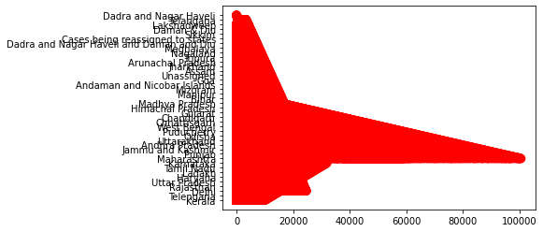
This plot indicate death rate in all states in India.
Majors death cases are near Maharashtra labels

Slide 19
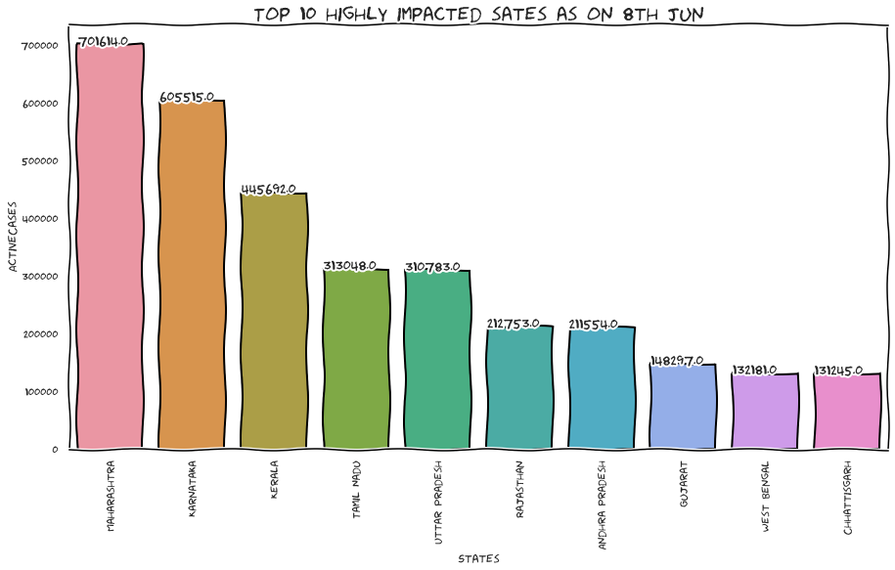

Slide 20
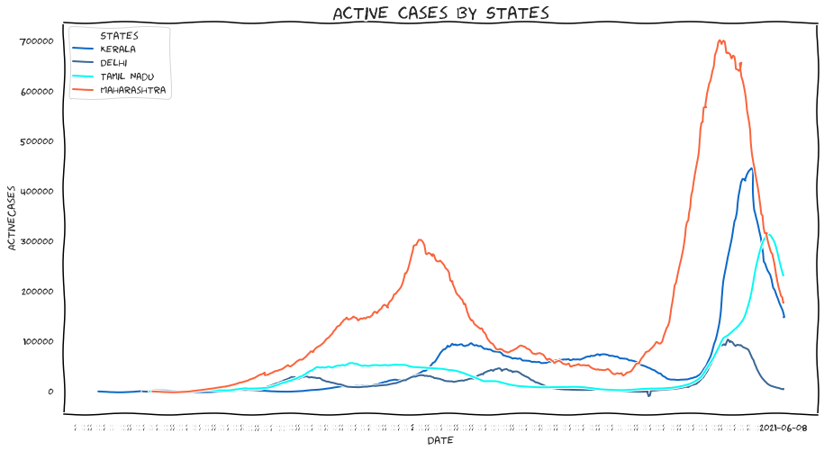

Slide 21
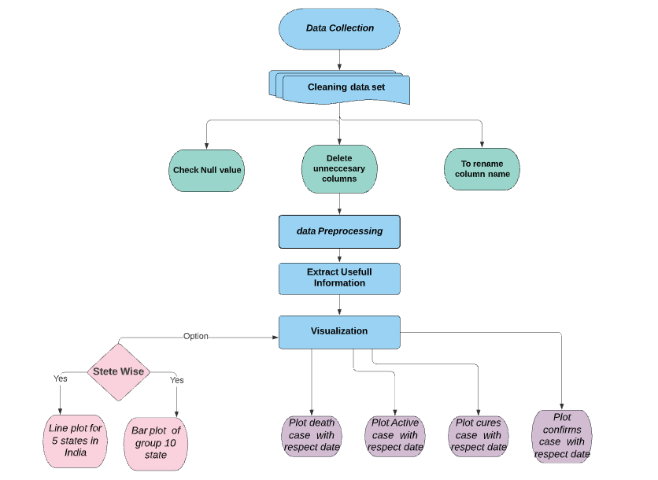
DFD DIAGRAMS
- Data Flow Diagram

Slide 22
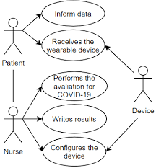
DFD DIAGRAMS
3.UseCase Diagram:

Slide 23
Future scope
We can analyse and predict by taking past data of COVID-19 virus cases
Everybody understand and aware the impact of Corona virus in a day to day life.
This information is most useful for News reporter, Doctors and Government to comprehend easily.

Slide 24
ADVANTAGEs
To visualization the COVID -19 cases in India.
Its easy to conclude confirmed, cures, death and active cases in india.
We can predict recovery rate by using visualization.
We can take caution and aware of the COVID-19 cases.
To find out the corona virus numbers of cases to the specific states and we update ourselves continuously.

Slide 25
DISADVANTAGEs
It is not possible to predict exactly and accurate prediction.
We cannot visualize future data.

Slide 26
Conclusion
To Extract useful information from data of COVID-19 upto the last date 08 jun 2021.
The historical data points that we can perceive some pattern and relevant facts.
Visualization showed that the majority of the COVID-19 cases in India.
In Order to remain safe, we should practice social distancing .
COVID-19 is still an unclear infectious disease.
The outbreak spreads are largely influenced by each country’s policy and social responsibility.

Slide 27
References
World Health Organization (WHO), "Coronavirus disease 2019 (COVID-19) Situation .

Slide 28
Thank You!

